Slide 1
Too Technical Preview
Turn on your slideshow to Preview

Slide 2


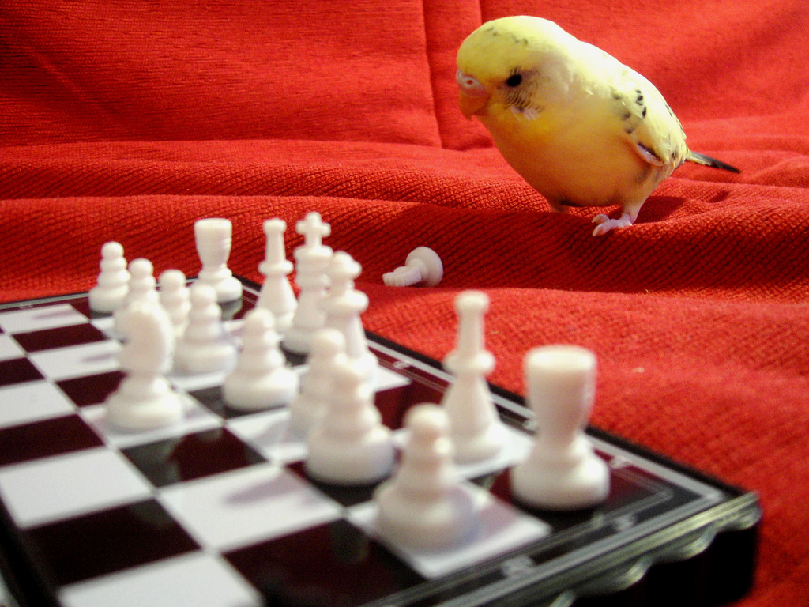
Use Your Arrow keys to go forwards and backwards
Backwards
Forward
Click To Exit

